Slide 1
MS Teams Advanced
-Amit Yadav

Slide 2
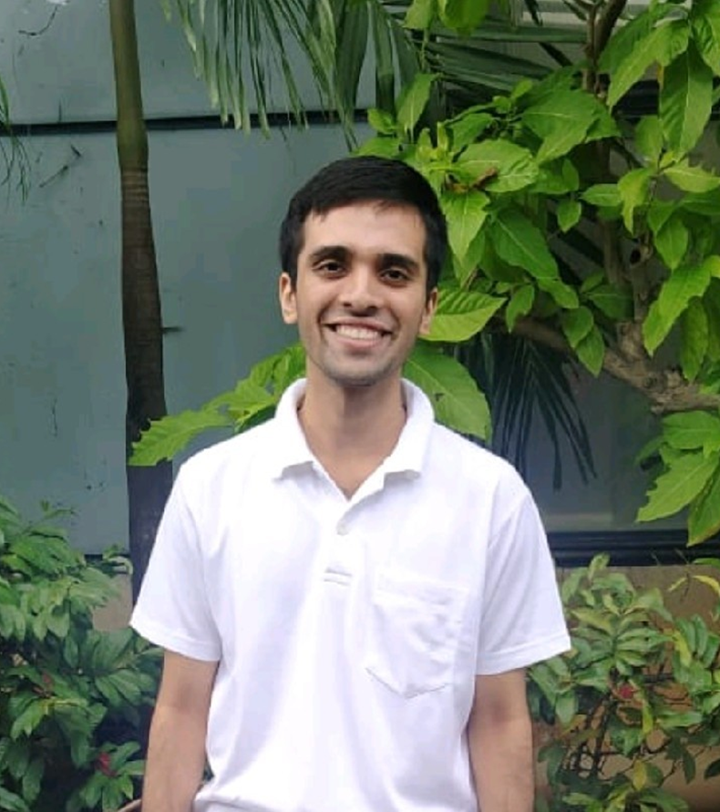
The Team
Amit Yadav
3rd year Undergrad student at
IIT Roorkee in GeophysicalTechnology’24
Tech Stack: Flutter/Dart, Firebase
I am the only guy in this project ,was sitting and chilling and came across the hackathon and thought to participate in it as all my mates are in home due to covid and I was the only one in the college due to network issue so this was the only way to engage my free time in.
Contact details:+91-9930617406

Slide 3
The Project
This project is basically an advanced version of the MS Teams with certain extra features. The current version of MS Teams has some basic features like Videocall, Chat, Assignments Upload etc. We have tried to improve the app by adding some extra functionalities.
We have implemented a multiple way authentication feature where all the credential details will be stored in firebase.
Current MS Teams was good but used to lack certain features in terms of security of the meeting code and anyone could intercept in any group meeting going on who had the group code so privacy was one of the main concern.
Increasing security by changing the joining code every time using some random function and adding a security code to join that particular meeting so that no 2 participants come by mistake to this meeting. The videocall functionality has been added with the help of Jitsi Meet.

Slide 4
The Project
Previously the calendar couldn't be edited in for short time period or long time period but now we can view the calendar or our scheduled events on a 2week or single week format.
Earlier when we had to share any hardcopy of a document, we couldn’t get a paste able pdf format so I had added a functionality of an OCR(Optical Character Recognition) which with the help of ML - DL helps in getting the document in an editable text format so that if we send the photo of a document all the text would be extracted from the document and would be edited easily using the flutter mobile vision package.
If we had to get any daily update of news, then we had to switch tabs multiple times but now I had added a functionality to view news within the app using API key from NewsApi.org
If we had to create a QR to transfer some confidential information, then there wasn't any possible way but here I have added a feature to make QR code or scan any QR code instantly.

Slide 5
The Project
Problems:
While being on the teams it was quite hard to keep track of our work and needed a to-do list to keep the track of the works.
When doing work, we needed a lot of hustle in changing the tabs to view news or any match score.
When we had to share any image which we had in hardcopy, or someone had clicked a photo then it was very difficult to extract the text out of the image and was very difficult to edit the info in them.

Slide 6
The Project
A to-do list helps in organizing the tasks and was of very much importance so I had also added a To-do list which was not available earlier ,here we would get a notification about the task when it is deleted.
Along with all these features I had added a functionality to chat where all the chat data will be stored in back-end in the firebase database and all the pictures shared in chat will b stored in firebase storage .When we receive a new message, we will be getting a notification about the message.
The Assignments uploaded will also be stored in a file in firebase storage.

Slide 7
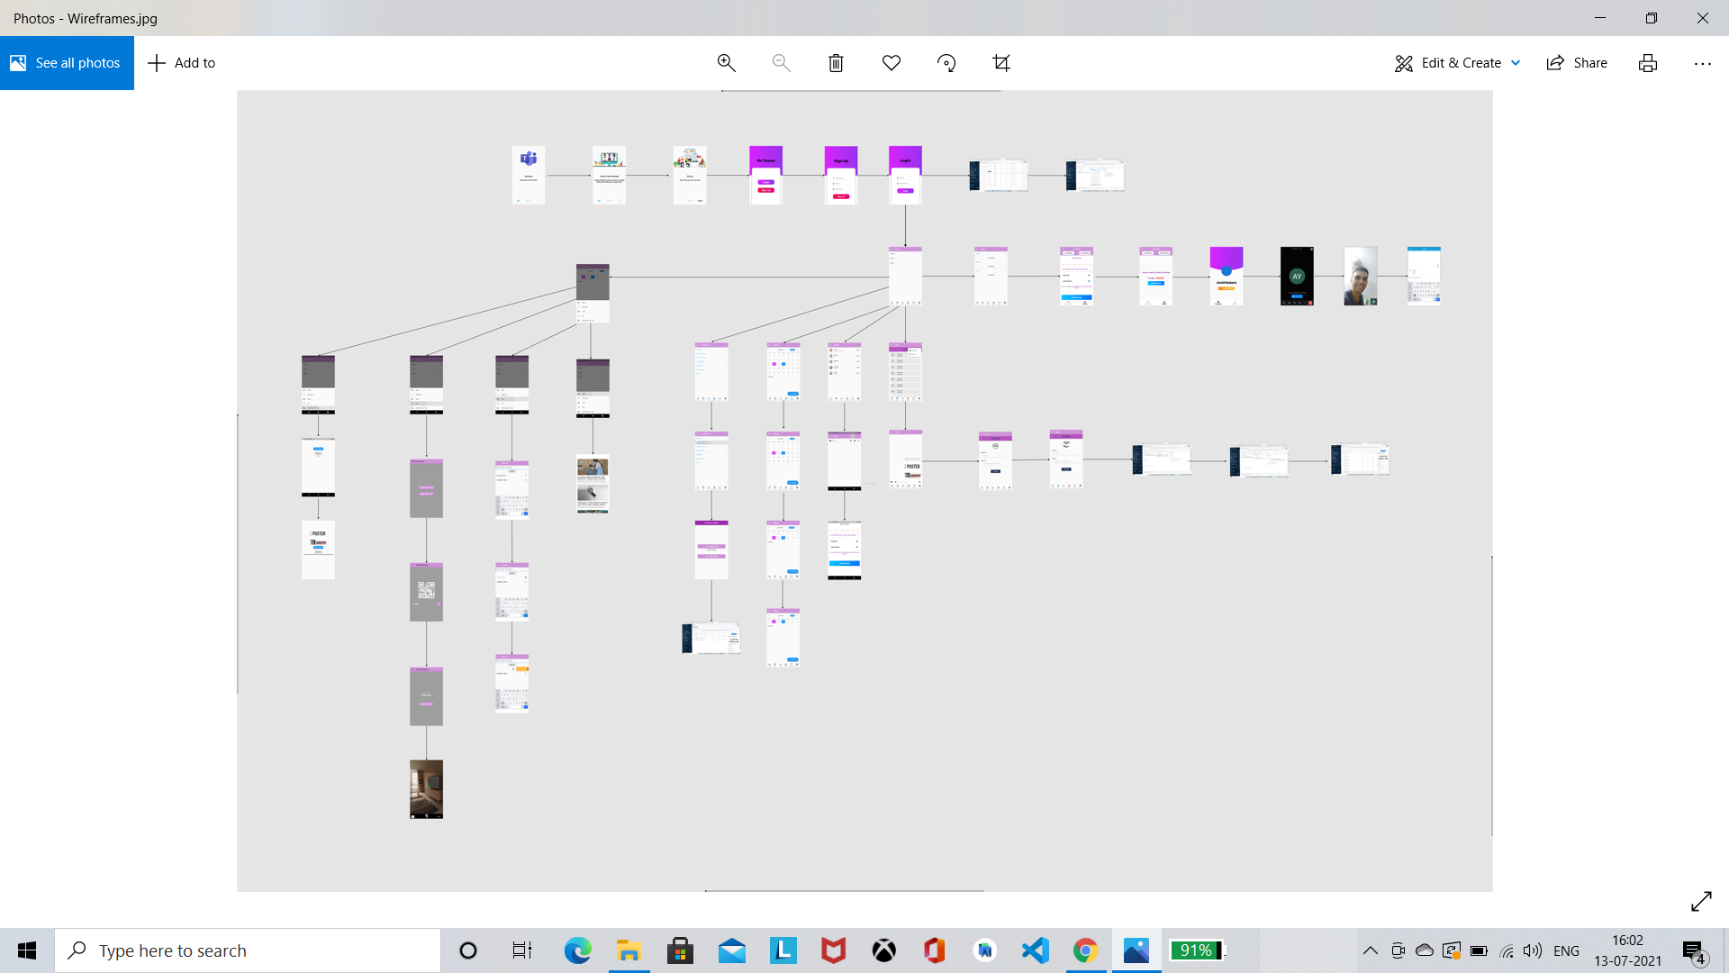
Wireframes
https://www.figma.com/file/aK161mKNgtSdQXGXMYLuK4/Untitled?node-id=0%3A1

Slide 8

Target Audience
During the time of COVID as the no. of people/businesses going online has increased by a large extent. From MS Teams going online has helped in conducting school, work, college, corporate people, almost everything has gone online from Junior KG students to 60-yr old managers who have their regular classes or meetings on a regular basis.

Slide 9
The total no. of students going to school/college /job online is almost 40% of our population. As there are still some population who either don’t have resources or lack funds or have network issues, but along with it there are smartphones with almost every person. Due to low cost of internet, there are also a large number of people who can afford online education or office going people who have all the facilities and also due to the no. of people doing online business also conduct online meetings as there are certain travel restrictions in COVID so therefore (0.4*120=48) 50 crore approximately people who are all our target audience, and our work was to improve their online interaction experience

Slide 10


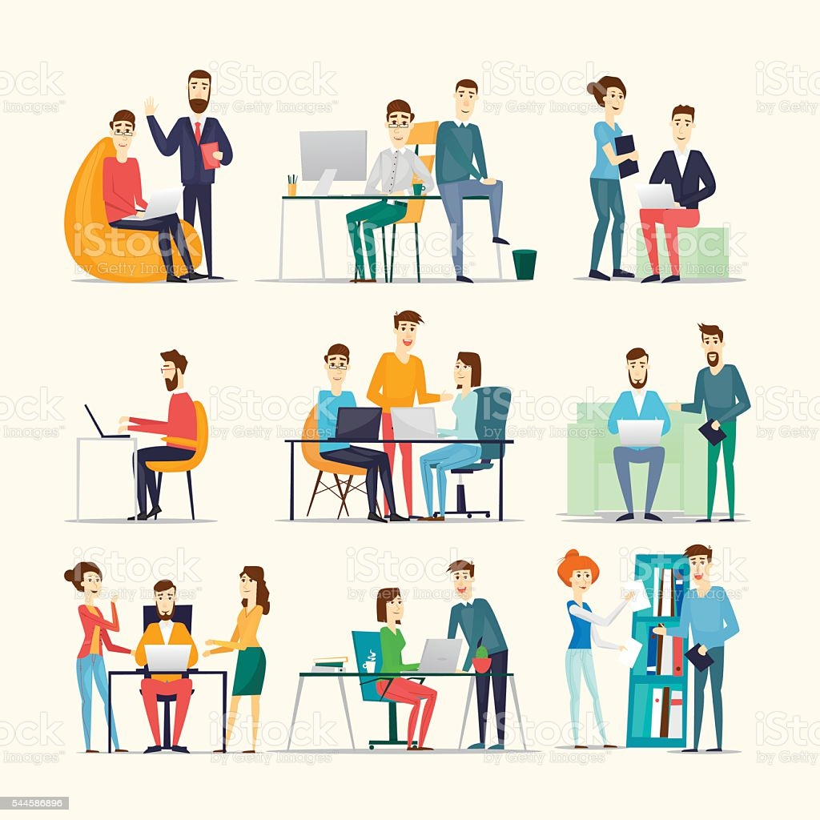

Slide 11
How it works
The app was made with the help of Flutter and Firebase as the backend and all the authentication details and chat data ,images shared in the chat and all the assignments uploaded were stored in the firebase storage.
The Video Calling feature in the app was feasible with the help of JITSI meet where I had used all of its features which include adding a security code to the particular meeting and we can join the videoconference by generating a random function every time before starting of the meet. We can also use AGORA SDK but I used Jitsi because it had many extra features preadded.
All the features were added with the help of various prebuild flutter packages which can be seen in the pubspec.yaml file.

Slide 12
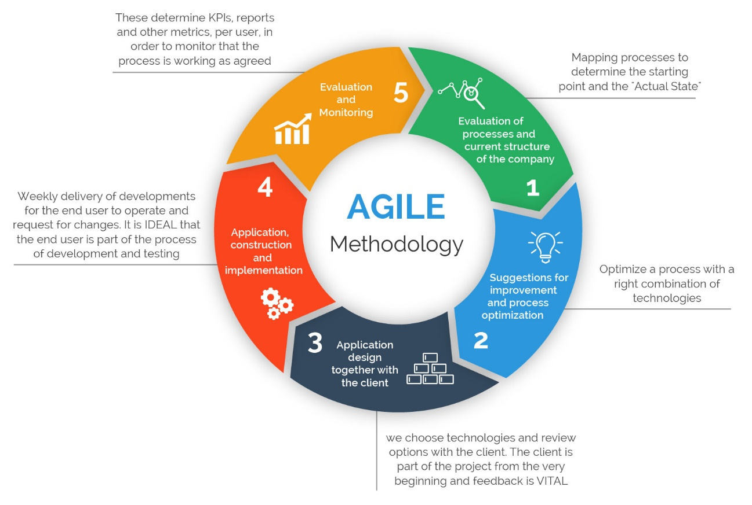
Production
AGILE methodology was followed during the production of this application. The tasks were completed on the priority basis where the development of the basic feature of MS Team i.e., Authentication ,Video Calling ,Chat and Assignment were implemented.
Later the other features like the OCR , To-do list , QR Scanner & Creator, real-time new feature were added to it.

Slide 13
Competition
Online meeting hosting platforms like Webex , MS Teams, ZOOM are also present but there are some features which all of them lack for example OCR, To-Do list ,Contracted calendar part and QR creator or scanner and along with it none of the apps have the feature of the real-time news.
My idea was also to add the graph creator feature which could be easily made on the mobile app if we lack resources of Laptop or PC but due to time constraints, I had to drop the idea.
OCR was the most needed option as when we capture the image and send as pdf it is very hard for us to convert it to editable format but now it can be easily done. OCR was made here with the help of some pre-existing packages or can be made using Tesseract API while none of the online platforms have any such feature.

Slide 14
Business Model
The way this project can make money is by providing memberships or premium features to some subscribed members/institutions.
Using Ads as a way to earn money is not an intelligent move to use here .
The chance of sustainability of its service would be quite high if we add some more important services to it like a graph maker and language translator as there can be many people making international calls with their clients and have a problem in carrying out the conversation so the language translator will help them make their task/conversation go easier.

Slide 15
Figma file for the project: https://www.figma.com/file/aK161mKNgtSdQXGXMYLuK4/Untitled?node-id=0%3A1
Frames: https://drive.google.com/drive/folders/1WCxp09Uj3X8_YdfPCDQWe3f2JW56Ub0N?usp=sharing
Github Link: https://github.com/amityadav10101010101010101010/MS_Teams_Clone
Video Link: https://youtu.be/cBp4ZQuvA4w

